Slide 1
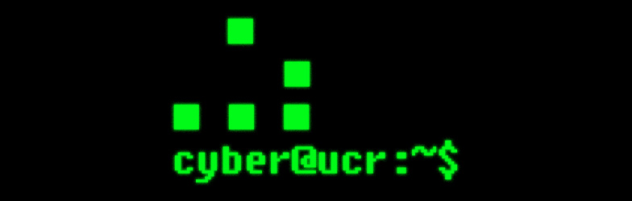

Slide 2
Types of Threats
Two principle attack types that concern you.
Social attacks (Social engineering)
Phishing
Vishing
Hacking you, the user.
Technical attacks
Most often victim-initiated
Using pirated software, out of date browsers, opening email attachments, etc.
Some “malware” (malicious software) may attempt to route your connection through a third party proxy server, allowing an attacker to capture your web traffic.
Sometimes caused by misconfiguration
Failing to update software (note: pirated software is rarely updated)
Bad settings at the network level
This is your sysadmin’s problem.
Exploits targeting insecure WiFi access points, lack of encryption.

Slide 3
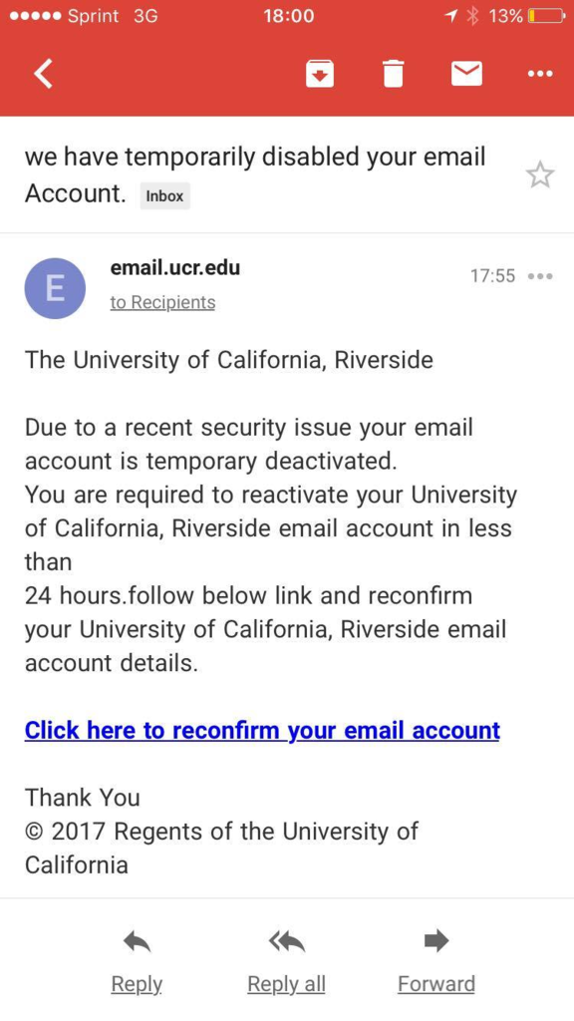
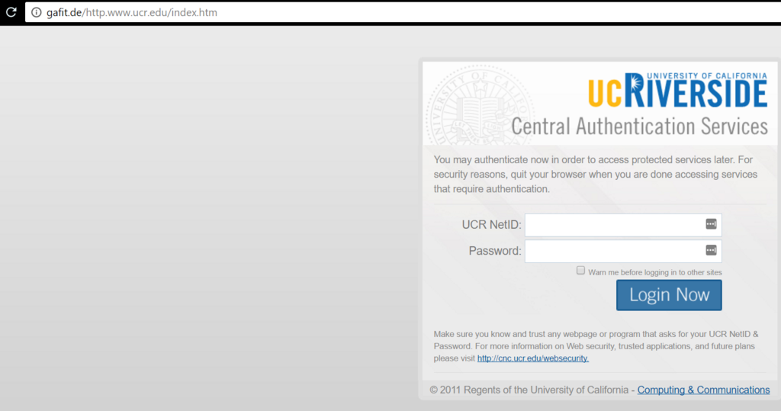
Social Engineering
Phishing and Vishing

Slide 4
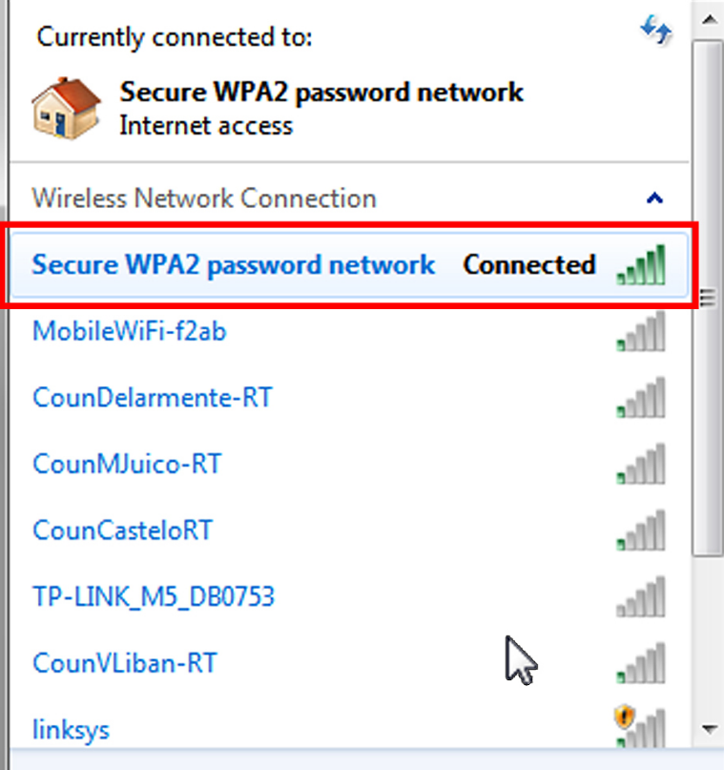
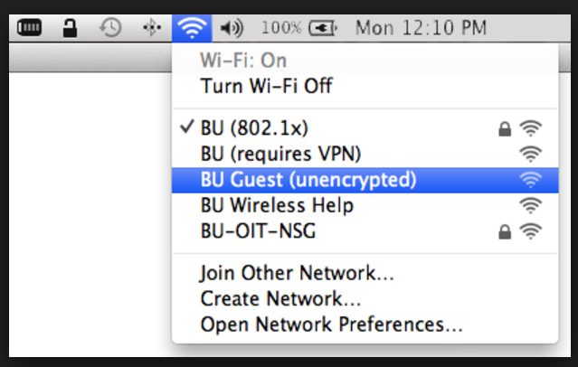
Technical Attacks
Technical attacks are usually victim initiated!
You are tricked into downloading malicious software.
You used pirated software or files that contain malicious software as a component.
Be careful using public WiFi
Some access points are unencrypted.
Evil Twin attacks
Use only trusted, encrypted connections for your most private transactions.
Banking, etc.

Slide 5
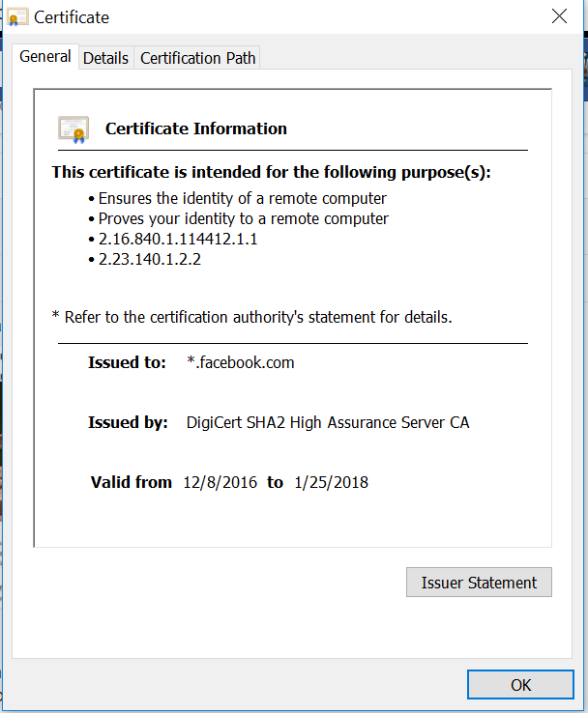
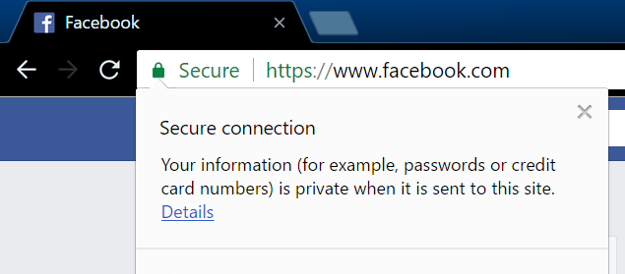
Technical attacks

Slide 6
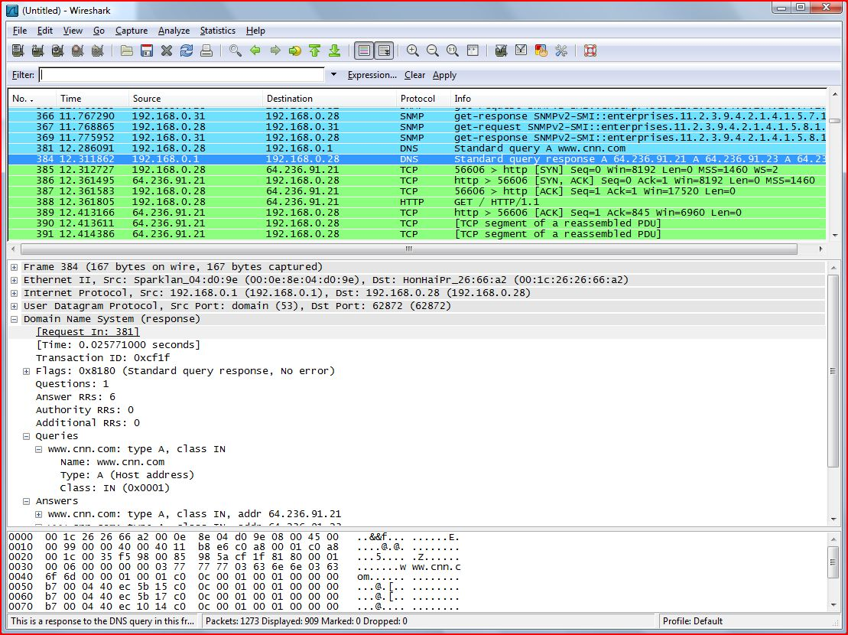
Technical attacks
Hackers can “sniff” (intercept and observe) network traffic sent over unsecure connections, such as the local Starbucks free wifi.
Your neighbor can do something similar if you “steal” his or her wifi.

Slide 7
Best Practices
Don’t provide login information. To anyone.
If they have a legitimate reason to access information in an account you control, then that organization will give them the access.
Remember: Security Questions, key numbers (like SID)
Use an encrypted connection (https) wherever possible.
If https is not working for you, then consider the possibility that you’ve been infected by malware.
Don’t download software from untrusted sources.
Piracy, email attachments, etc.
Keep software up-to-date.
Exploits target out of date software.

Slide 8
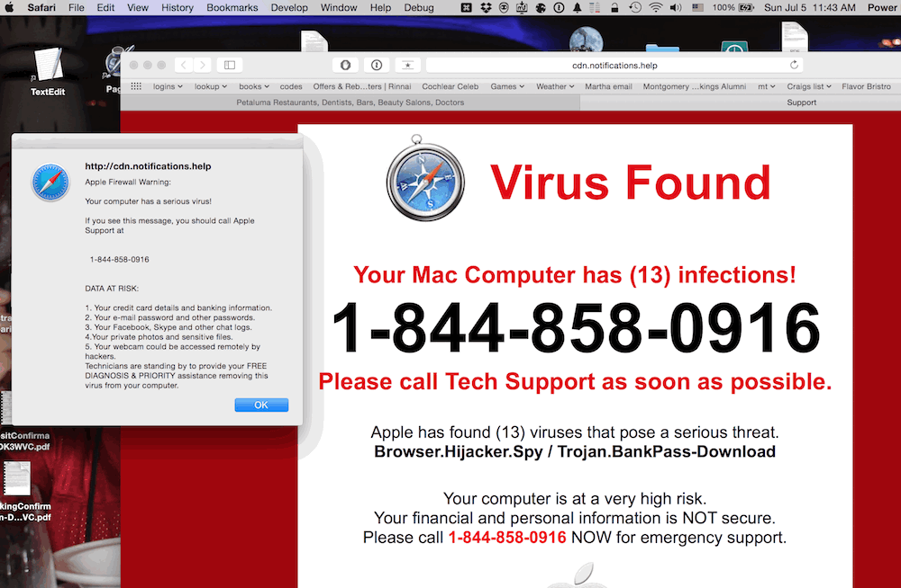
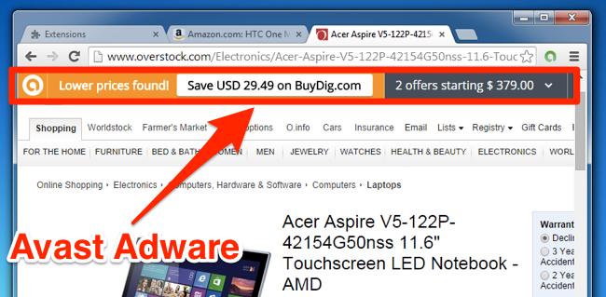
Best Practices
Watch out for malware
Computer behaves strangely.
Weird proxies redirecting you to sites other than the one you typed in.
Pop up ads.
Unusual ads integrated into web pages that weren’t there before (and aren’t on other computers)

Slide 9
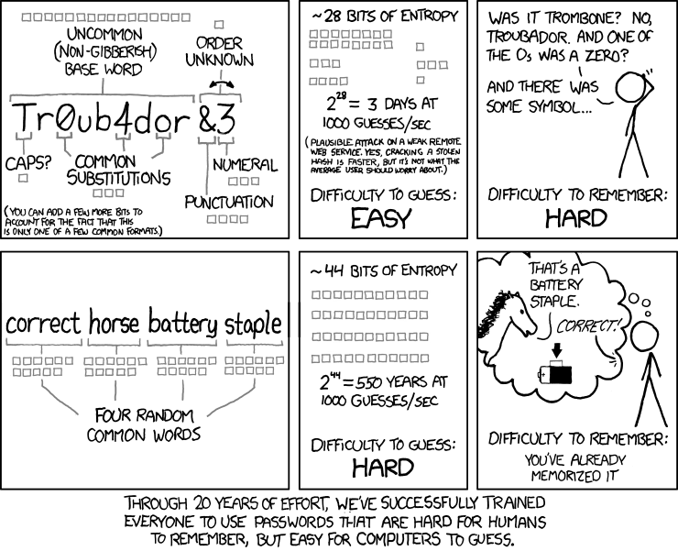
Best Practices
Use a Strong Password
Use common sense here.
LastPass and 1Password

Slide 10
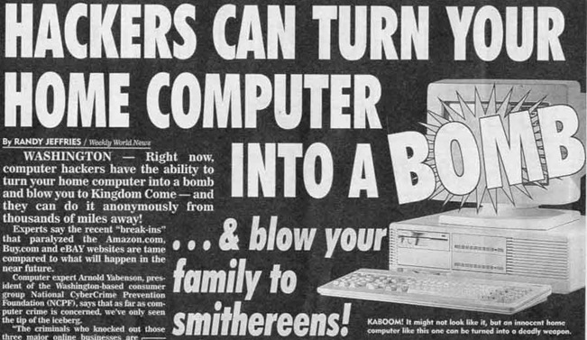
Conclusion
Hackers are scary, but remember that most attacks are victim initiated.
Black belts and mixed martial artists exist, but you’re normally not worried about meeting one in a parking lot.
Have a sensible threat model.
It’s impossible to stop a determined, persistent threat, but basic best practices make you harder (and therefore less worthwhile) to attack.
(no they can’t)
Would you like to know more? https://decentsecurity.com/
(https all day)

